Slide 1
Data 606 - Capstone in Data Science
PRESENTED BY
Kavya Ravi
Omkar Katkade

Slide 2
INTRODUCTION
Diabetes is a chronic condition that affects how your body processes blood sugar.
Types of Diabetes:
Type 1: Your body doesn't produce insulin.
Type 2: Your body doesn't use insulin properly, leading to high blood sugar levels.
Gestational Diabetes: High blood sugar during pregnancy.

Slide 3
DATASET
General Population Diabetes Dataset:
Features: High Blood Pressure, BMI, Physical Activity, Heart Disease, Alcohol Consumption, Age, Sex, etc.
Pregnancy Diabetes Data:
Features: Age, BMI, Blood Pressure, Insulin level, Glucose level, Diabetes Pedigree Function, and more.

Slide 4
Methodology
Data Gathering: Collect relevant diabetes datasets.
Data Preprocessing: Clean, remove outliers, handle missing data, and normalize or scale the data.
Feature Selection: Select the most relevant variables for diabetes prediction.
Data Model: Try out various models and choose the most accurate one.
Model Evaluation: Assess the trained model's performance using a validation set.

Slide 5
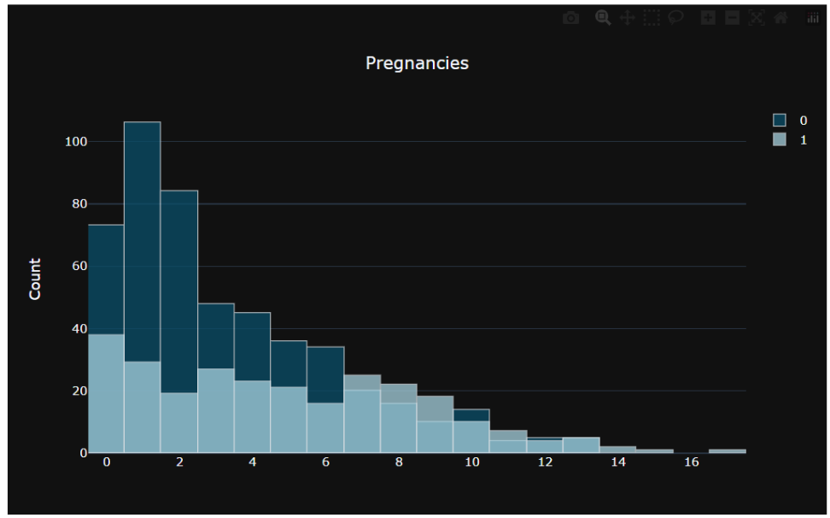
EDA and Visualizations For Pregnant Women Dataset
Number of Pregnancies VS Diabetes
Inference: Number of Pregnancies is directly proportional to Diabetes

Slide 6
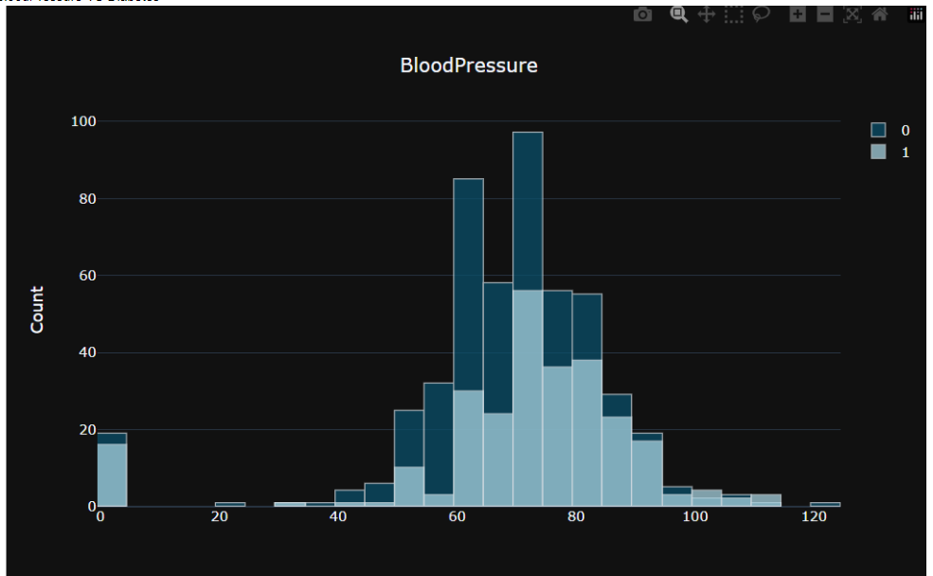
EDA and Visualizations For Pregnant Women Dataset
Blood Pressure VS Diabetes
Inference: Blood Pressure plays a crucial role in determining diabetes in pregnant women

Slide 7
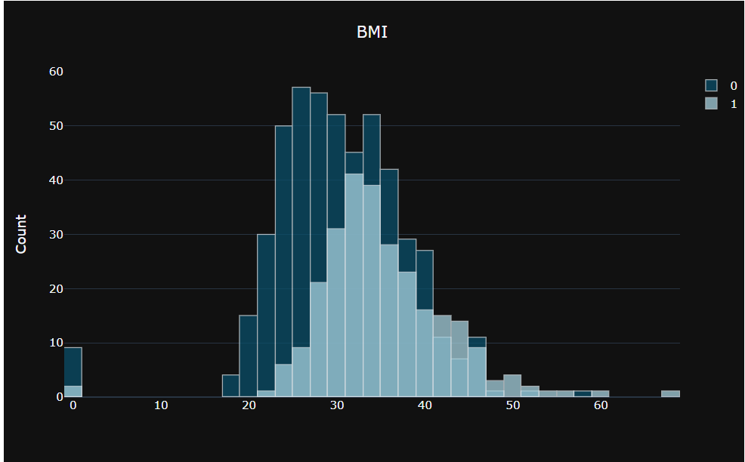
EDA and Visualizations For Pregnant Women Dataset
BMI VS Diabetes
Inference: High BMI values are associated with increased risk for developing diabetes

Slide 8
Data Models and Results For Pregnant Women Dataset
For this dataset, we trained three different Models and following are their prediction accuracy scores.
1. Support Vector Machine (SVM): Achieved a prediction accuracy of 77.04%.
2. Support Vector Classifier (SVC): Demonstrated a prediction accuracy of 76.623%.
3. Logistic Regression Model: Attained a prediction accuracy of 75.97%.

Slide 9
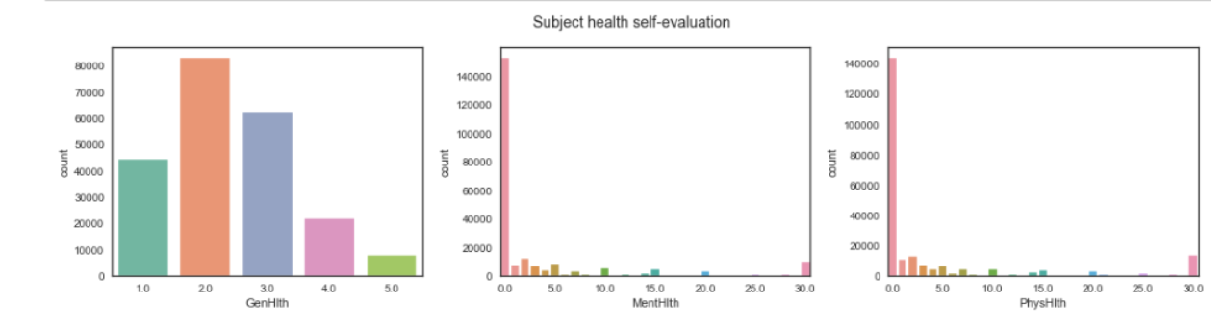
EDA and Visualizations For General Population Dataset
Patient Profile Evaluation
Inference: Most of the people (even if diabetic) are healthy in the general health category.
Mental and Physical health of most of population is very good although there are significant amount of patients with mental and physical distress.

Slide 10
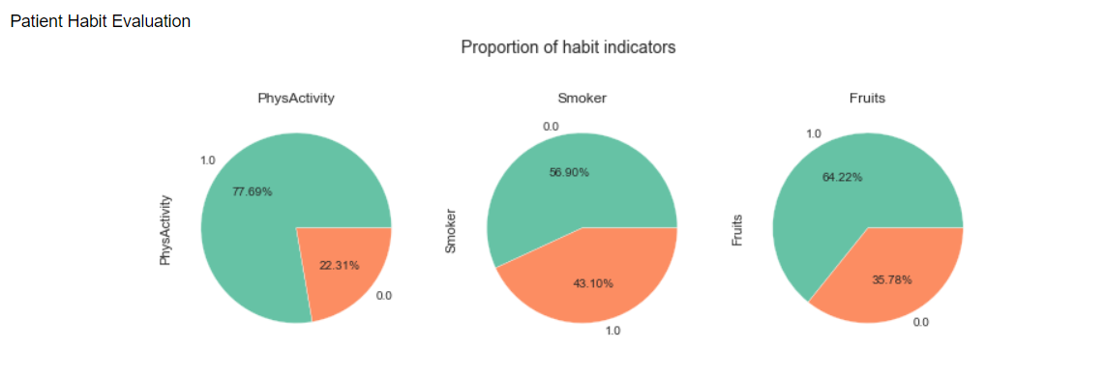
EDA and Visualizations For General Population Dataset
Patient Habit Evaluation

Slide 11
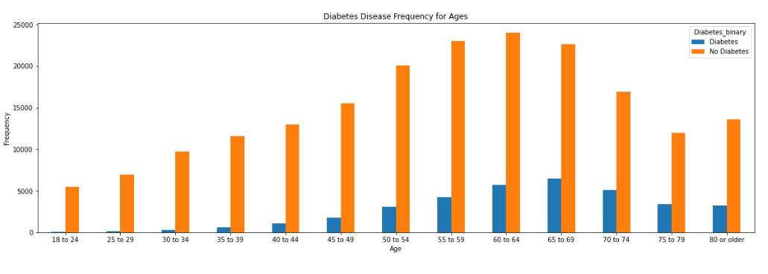
EDA and Visualizations For General Population Dataset
Patient Age VS Diabetes

Slide 12
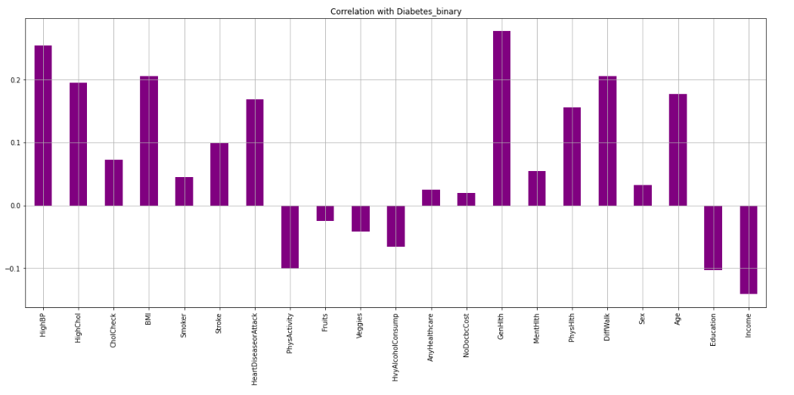
EDA and Visualizations For General Population Dataset

Slide 13
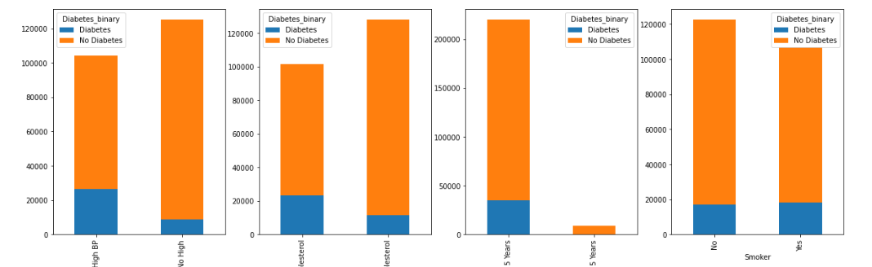
EDA and Visualizations For General Population Dataset
Patient Habit Evaluation

Slide 14
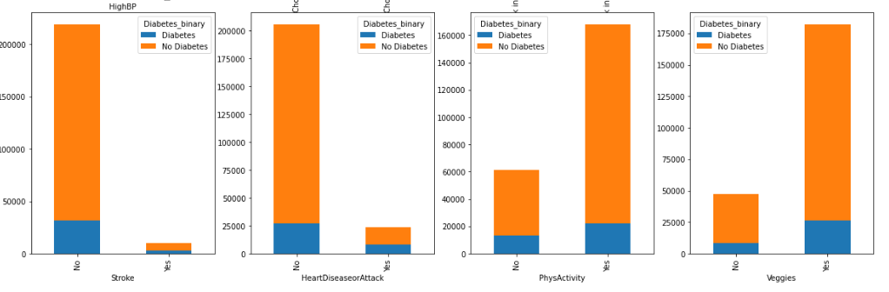
EDA and Visualizations For General Population Dataset

Slide 15
Data Models and Results For General Population Dataset
For this dataset, we trained three different Models and following are their prediction accuracy scores.
1. Logistic Regression: Demonstrated an impressive prediction accuracy of 97.87% .
2. Random Forest: Demonstrated a prediction accuracy of 99.89%.
3. Decision: Attained a prediction accuracy of 99.83%.

Slide 16
Thank You.

